Slide 1
Energy Efficiency in Building Design: A Data Science Approach

Slide 2
Dataset Overview
Attributes:
X1-Relative Compactness
X2-Surface Area
X3-Wall Area
X4-Roof Area
X5-Overall Height
X6-Orientation
X7-Glazing Area
X8-Glazing Area Distribution
Window To Wall Ratio
Target:
Y1-Heating Load
Y2-Cooling Load

Slide 3
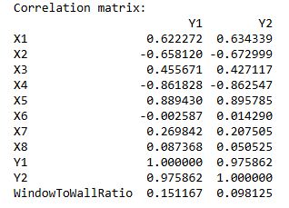
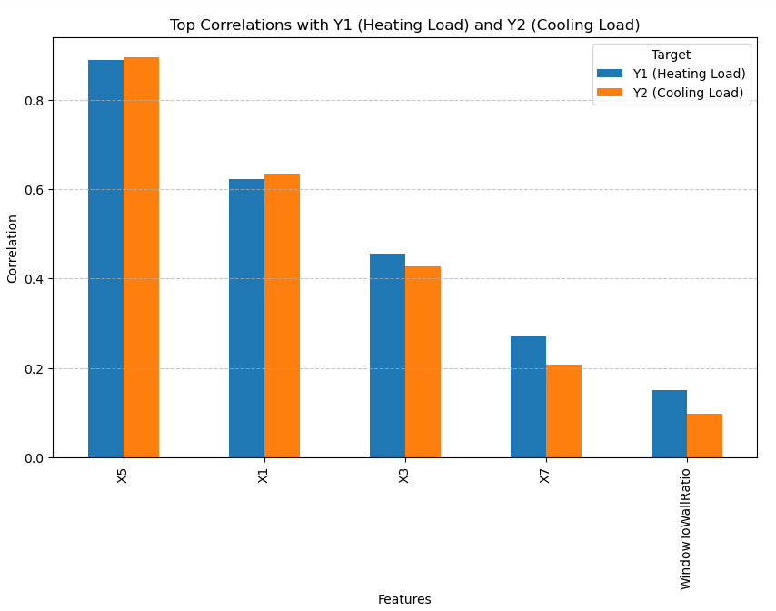
Insights from Exploratory Data Analysis

Slide 4

Feature Engineering
Window To Wall Ratio
WindowToWallRatio=$\frac{X7(\text{Glazing} \text{Area} )}{X3(\text{Wall} \text{Area} )}$
Critical feature often used in energy performance analysis.
Glazing and wall area interact significantly to influence energy performance.

Slide 5
Modeling
Used Attributes in this model:
X1-Relative Compactness
X3-Wall Area
X5-Overall Height
X7-Glazing Area
Window To Wall Ratio

Slide 6
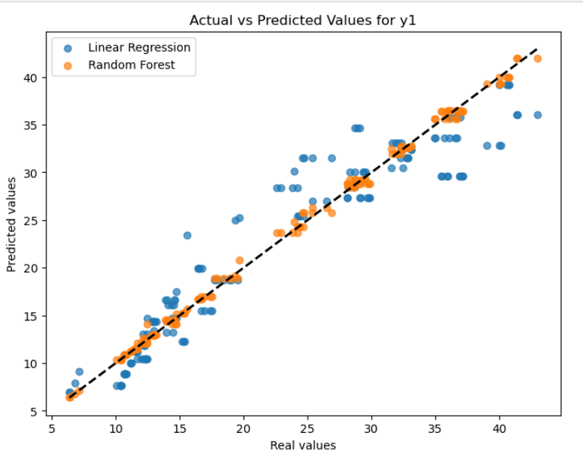
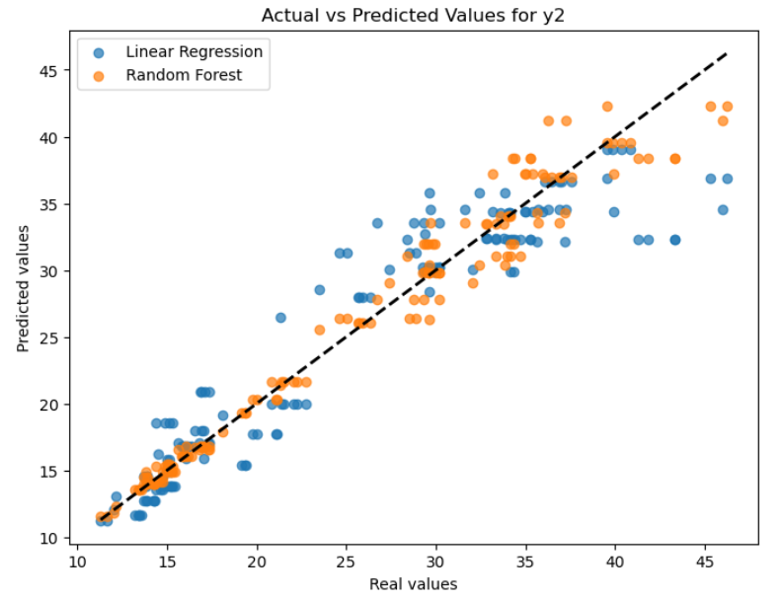
Results

